Slide 1
01 - Introduction to Linguistics
Nick Riches
Introduction
Why SLTS need to know about linguistics
01 - Introduction to Linguistics
What is linguistics?
What is syntax? What is semantics? What is pragmatics What is phonology? Crossing over Subfields of linguistics
Nick Riches
Newcastle University
Approaches to language structure
Prescriptive grammars - how we SHOULD speak
Descriptive grammars - how we ACTUALLY speak
Mental grammars - the underlying system
October 2, 2019
A communicative view of language
A communicative view
Relationship with SLT practice
5-minute exercise
5-minute ex
1 / 32

Slide 2
01 - Introduction to Linguistics
Nick Riches
Introduction
Why SLTS need to know about linguistics
Introduction
What is linguistics?
What is syntax? What is semantics? What is pragmatics What is phonology? Crossing over Subfields of linguistics
What is linguistics?
Approaches to language structure
Approaches to language structure
Prescriptive grammars - how we SHOULD speak
Descriptive grammars - how we ACTUALLY speak
Mental grammars - the underlying system
A communicative view of language
5-minute exercise
A communicative view of language
A communicative view
Relationship with SLT practice
5-minute exercise
5-minute ex
1 / 32

Slide 3
Why SLTS need to know about linguistics
01 - Introduction to Linguistics
Nick Riches
Introduction
Why SLTS need to know about linguistics
What is linguistics?
What is syntax? What is semantics? What is pragmatics What is phonology? Crossing over Subfields of linguistics
Him go there
Approaches to language structure
Prescriptive grammars - how we SHOULD speak
Descriptive grammars - how we ACTUALLY speak
Mental grammars - the underlying system
A communicative view of language
A communicative view
Relationship with SLT practice
5-minute exercise
5-minute ex
2 / 32

Slide 4
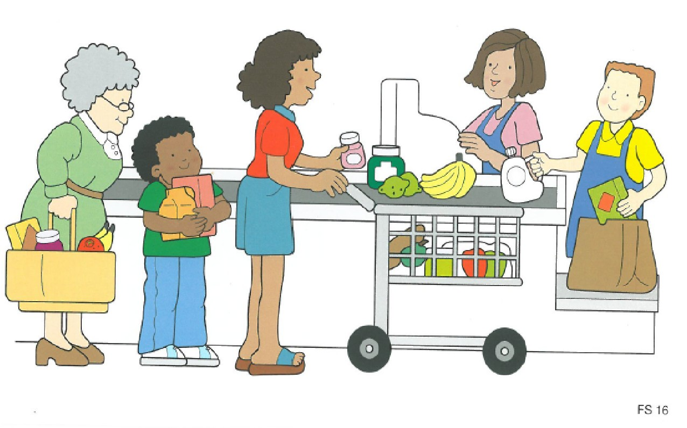
Why SLTS need to know about linguistics
01 - Introduction to Linguistics
Nick Riches
Introduction
Why SLTS need to know about linguistics
What is linguistics?
What is syntax? What is semantics? What is pragmatics What is phonology? Crossing over Subfields of linguistics
Approaches to language structure
Prescriptive grammars - how we SHOULD speak
Descriptive grammars - how we ACTUALLY speak
Mental grammars - the underlying system
A communicative view of language
A communicative view
Relationship with SLT practice
5-minute exercise
5-minute ex
3 / 32

Slide 5
Why SLTS need to know about linguistics
01 - Introduction to Linguistics
Nick Riches
Introduction
Why SLTS need to know about linguistics
What is linguistics?
What is syntax? What is semantics? What is pragmatics What is phonology? Crossing over Subfields of linguistics
Diagnose language impairments
Identify targets for therapy
Devise new therapies
Approaches to language structure
Prescriptive grammars - how we SHOULD speak
Descriptive grammars - how we ACTUALLY speak
Mental grammars - the underlying system
A communicative view of language
A communicative view
Relationship with SLT practice
5-minute exercise
5-minute ex
4 / 32

Slide 6
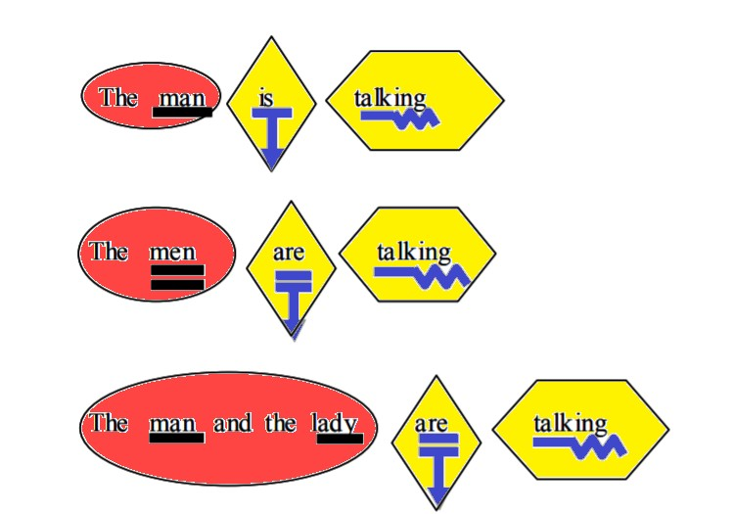
Why SLTS need to know about linguistics
01 - Introduction to Linguistics
Nick Riches
Susan Ebbel’s shape coding
Introduction
Why SLTS need to know about linguistics
What is linguistics?
What is syntax? What is semantics? What is pragmatics What is phonology? Crossing over Subfields of linguistics
Approaches to language structure
Prescriptive grammars - how we SHOULD speak
Descriptive grammars - how we ACTUALLY speak
Mental grammars - the underlying system
A communicative view of language
A communicative view
Relationship with SLT practice
5-minute exercise
5-minute ex
5 / 32

Slide 7
01 - Introduction to Linguistics
Nick Riches
Introduction
Why SLTS need to know about linguistics
Introduction
What is linguistics?
What is syntax? What is semantics? What is pragmatics What is phonology? Crossing over Subfields of linguistics
What is linguistics?
Approaches to language structure
Approaches to language structure
Prescriptive grammars - how we SHOULD speak
Descriptive grammars - how we ACTUALLY speak
Mental grammars - the underlying system
A communicative view of language
5-minute exercise
A communicative view of language
A communicative view
Relationship with SLT practice
5-minute exercise
5-minute ex
5 / 32

Slide 8
01 - Introduction to Linguistics
Nick Riches
Introduction
Why SLTS need to know about linguistics
What is linguistics?
What is syntax? What is semantics? What is pragmatics What is phonology? Crossing over Subfields of linguistics
The study of language, consisting of 4 subdomains
syntax: language structure
semantics: linguistic meaning
phonology: the sound system of language
pragmatics: language in context
Approaches to language structure
Prescriptive grammars - how we SHOULD speak
Descriptive grammars - how we ACTUALLY speak
Mental grammars - the underlying system
A communicative view of language
A communicative view
Relationship with SLT practice
5-minute exercise
5-minute ex
6 / 32

Slide 9
What is syntax?
01 - Introduction to Linguistics
Nick Riches
Introduction
Why SLTS need to know about linguistics
Syntax covers the structural properties of language, e.g. word order
English (SVO)
What is linguistics?
What is syntax? What is semantics? What is pragmatics What is phonology? Crossing over Subfields of linguistics
(1) | Tom | watches | TV | Approaches to
 |  |  |  | language structure
 |  |  |  | Prescriptive grammars - how we SHOULD speak
 |  |  |  | Descriptive grammars - how we ACTUALLY speak
 |  |  |  | Mental grammars - the underlying system
 |  |  |  | A communicative view of language
 |  |  |  | A communicative view
 |  |  |  | Relationship with SLT practice
 |  |  |  | 5-minute exercise
 |  |  |  | 5-minute ex
7 / 32

Slide 10
What is syntax?
01 - Introduction to Linguistics
Nick Riches
Introduction
Why SLTS need to know about linguistics
Syntax covers the structural properties of language, e.g. word order
English (SVO)
Tom watches TV Japanese (SOV)
Tom-san-wa Terebi-o mimashita
What is linguistics?
What is syntax? What is semantics? What is pragmatics What is phonology? Crossing over Subfields of linguistics
Approaches to language structure
Prescriptive grammars - how we SHOULD speak
Descriptive grammars - how we ACTUALLY speak
Mental grammars - the underlying system
A communicative view of language
A communicative view
Relationship with SLT practice
5-minute exercise
5-minute ex
7 / 32

Slide 11
What is syntax?
01 - Introduction to Linguistics
Nick Riches
Introduction
Why SLTS need to know about linguistics
What is linguistics?
What is syntax? What is semantics? What is pragmatics What is phonology? Crossing over Subfields of linguistics
Movement
What
are
you t doing ?
(3)
Approaches to language structure
Prescriptive grammars - how we SHOULD speak
Descriptive grammars - how we ACTUALLY speak
Mental grammars - the underlying system
Aux. verb
A communicative
view of language
A communicative view
Relationship with SLT practice
5-minute exercise
5-minute ex
8 / 32

Slide 12
What is semantics?
01 - Introduction to Linguistics
Nick Riches
Introduction
Why SLTS need to know about linguistics
What is linguistics?
What is syntax? What is semantics? What is pragmatics What is phonology? Crossing over Subfields of linguistics
How are word meanings represented / expressed? How are word meanings combined to form sentence meanings?
Compositionality = the meaning of the whole is composed of the meaning of the parts
Approaches to language structure
Prescriptive grammars - how we SHOULD speak
Descriptive grammars - how we ACTUALLY speak
Mental grammars - the underlying system
The Queen of England likes Corgis
The Queen of England likes Dachsunds
A communicative view of language
A communicative view
Relationship with SLT practice
5-minute exercise
5-minute ex

Slide 13
What is pragmatics
01 - Introduction to Linguistics
Nick Riches
Introduction
Why SLTS need to know about linguistics
What is linguistics?
What is syntax? What is semantics? What is pragmatics What is phonology? Crossing over Subfields of linguistics
The study of language in context
A: Do you want to see Mission Impossible V? B: I don’t like action movies.
Approaches to language structure
Prescriptive grammars - how we SHOULD speak
Descriptive grammars - how we ACTUALLY speak
Mental grammars - the underlying system
A communicative view of language
A communicative view
Relationship with SLT practice
5-minute exercise
5-minute ex

Slide 14
What is phonology?
01 - Introduction to Linguistics
Nick Riches
Introduction
Why SLTS need to know about linguistics
What is linguistics?
What is syntax? What is semantics? What is pragmatics What is phonology? Crossing over Subfields of linguistics
Ask Ghada and Jalal!!
Approaches to language structure
Prescriptive grammars - how we SHOULD speak
Descriptive grammars - how we ACTUALLY speak
Mental grammars - the underlying system
A communicative view of language
A communicative view
Relationship with SLT practice
5-minute exercise
5-minute ex

Slide 15
Crossing over
01 - Introduction to Linguistics
Nick Riches
Introduction
Why SLTS need to know about linguistics
What is linguistics?
What is syntax? What is semantics? What is pragmatics What is phonology? Crossing over Subfields of linguistics
Benefactive
Agent
Patient
Approaches to language structure
Prescriptive grammars - how we SHOULD speak
Descriptive grammars - how we ACTUALLY speak
Mental grammars - the underlying system
Amy gave a cake to Sean
(4)
A communicative view of language
A communicative view
Relationship with SLT practice
5-minute exercise
5-minute ex

Slide 16
Subfields of linguistics
01 - Introduction to Linguistics
Nick Riches
Introduction
Why SLTS need to know about linguistics
What is linguistics?
What is syntax? What is semantics? What is pragmatics What is phonology? Crossing over Subfields of linguistics
Theoretical linguistics Psycholinguistics Sociolinguistics Discourse studies
Approaches to language structure
Prescriptive grammars - how we SHOULD speak
Descriptive grammars - how we ACTUALLY speak
Mental grammars - the underlying system
A communicative view of language
A communicative view
Relationship with SLT practice
5-minute exercise
5-minute ex
13 / 32

Slide 17
01 - Introduction to Linguistics
Nick Riches
Introduction
Why SLTS need to know about linguistics
Introduction
What is linguistics?
What is syntax? What is semantics? What is pragmatics What is phonology? Crossing over Subfields of linguistics
What is linguistics?
Approaches to language structure
Approaches to language structure
Prescriptive grammars - how we SHOULD speak
Descriptive grammars - how we ACTUALLY speak
Mental grammars - the underlying system
A communicative view of language
5-minute exercise
A communicative view of language
A communicative view
Relationship with SLT practice
5-minute exercise
5-minute ex
13 / 32

Slide 18
Prescriptive grammars - how we SHOULD speak
01 - Introduction to Linguistics
Nick Riches
Introduction
Why SLTS need to know about linguistics
What is linguistics?
What is syntax? What is semantics? What is pragmatics What is phonology? Crossing over Subfields of linguistics
(5) I have
n’t
got
no
money
(6) I ca
n’t
get
satisfaction
Approaches to language structure
Prescriptive grammars - how we SHOULD speak
Descriptive grammars - how we ACTUALLY speak
Mental grammars - the underlying system
no
A communicative view of language
A communicative view
Relationship with SLT practice
5-minute exercise
5-minute ex

Slide 19

Prescriptive grammars - how we SHOULD speak
01 - Introduction to Linguistics
Nick Riches
It must be remembered that two negatives in the English language destroy each other and are equivalent to an affirmative. Often we hear such expressions as ”He was not asked to give no opinion,” expressing the very opposite of what is intended. The double negative, therefore, should be carefully avoided, for it is insidious. (from ”How to write with clarity”)
Introduction
Why SLTS need to know about linguistics
What is linguistics?
What is syntax? What is semantics? What is pragmatics What is phonology? Crossing over Subfields of linguistics
Approaches to language structure
Prescriptive grammars - how we SHOULD speak
Descriptive grammars - how we ACTUALLY speak
Mental grammars - the underlying system
A communicative view of language
A communicative view
Relationship with SLT practice
5-minute exercise
5-minute ex

Slide 20
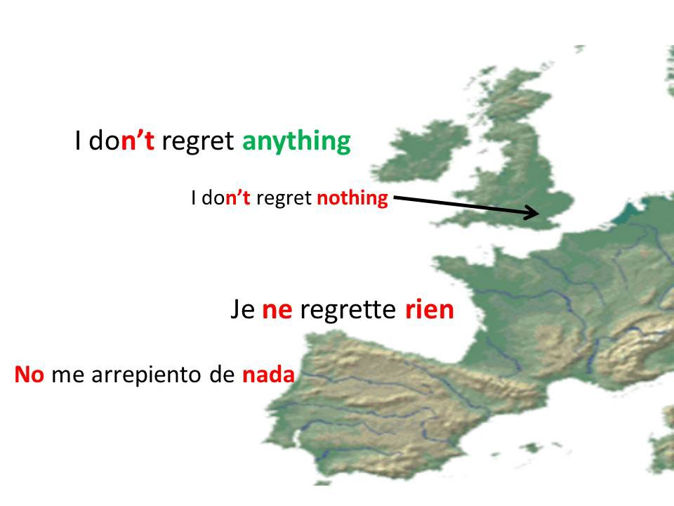
Prescriptive grammars - how we SHOULD speak
01 - Introduction to Linguistics
Nick Riches
Introduction
Why SLTS need to know about linguistics
What is linguistics?
What is syntax? What is semantics? What is pragmatics What is phonology? Crossing over Subfields of linguistics
Approaches to language structure
Prescriptive grammars - how we SHOULD speak
Descriptive grammars - how we ACTUALLY speak
Mental grammars - the underlying system
A communicative view of language
A communicative view
Relationship with SLT practice
5-minute exercise
5-minute ex

Slide 21
Prescriptive grammars - how we SHOULD speak
01 - Introduction to Linguistics
The use of ”hopefully”
Nick Riches
Introduction
Why SLTS need to know about linguistics
(7) The dog looked hopefully at the food on the kitchen worksurface (NORMAL ADVERB)
What is linguistics?
What is syntax? What is semantics? What is pragmatics What is phonology? Crossing over Subfields of linguistics
Approaches to language structure
Prescriptive grammars - how we SHOULD speak
Descriptive grammars - how we ACTUALLY speak
Mental grammars - the underlying system
A communicative view of language
A communicative view
Relationship with SLT practice
5-minute exercise
5-minute ex
17 / 32

Slide 22
Prescriptive grammars - how we SHOULD speak
01 - Introduction to Linguistics
The use of ”hopefully”
Nick Riches
Introduction
Why SLTS need to know about linguistics
(7) The dog looked hopefully at the food on the kitchen worksurface (NORMAL ADVERB)
What is linguistics?
What is syntax? What is semantics? What is pragmatics What is phonology? Crossing over Subfields of linguistics
(8) Hopefully, it won’t rain this morning (SENTENTIAL ADVERB)
Approaches to language structure
Prescriptive grammars - how we SHOULD speak
Descriptive grammars - how we ACTUALLY speak
Mental grammars - the underlying system
A communicative view of language
A communicative view
Relationship with SLT practice
5-minute exercise
5-minute ex
17 / 32

Slide 23
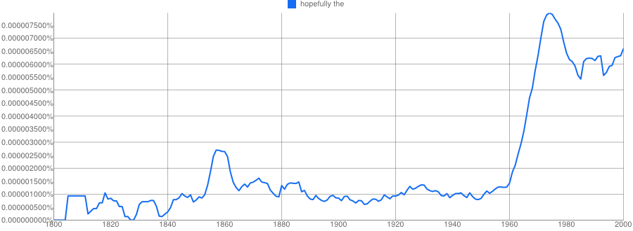
Prescriptive grammars - how we SHOULD speak
01 - Introduction to Linguistics
The use of ”hopefully”
Nick Riches
Introduction
Why SLTS need to know about linguistics
(7) The dog looked hopefully at the food on the kitchen worksurface (NORMAL ADVERB)
What is linguistics?
What is syntax? What is semantics? What is pragmatics What is phonology? Crossing over Subfields of linguistics
(8) Hopefully, it won’t rain this morning (SENTENTIAL ADVERB)
Approaches to language structure
Prescriptive grammars - how we SHOULD speak
Descriptive grammars - how we ACTUALLY speak
Mental grammars - the underlying system
A communicative view of language
A communicative view
Relationship with SLT practice
5-minute exercise
5-minute ex
17 / 32

Slide 24
Prescriptive grammars - how we SHOULD speak
01 - Introduction to Linguistics
The use of ”hopefully”
Nick Riches
Introduction
Why SLTS need to know about linguistics
(7) The dog looked hopefully at the food on the kitchen worksurface (NORMAL ADVERB)
What is linguistics?
What is syntax? What is semantics? What is pragmatics What is phonology? Crossing over Subfields of linguistics
(8) Hopefully, it won’t rain this morning (SENTENTIAL ADVERB)
Approaches to language structure
Prescriptive grammars - how we SHOULD speak
Descriptive grammars - how we ACTUALLY speak
Mental grammars - the underlying system
A communicative view of language
A communicative view
Relationship with SLT practice
5-minute exercise
5-minute ex
Only accepted by Style Guide of the Applied Press in 2012
17 / 32

Slide 25
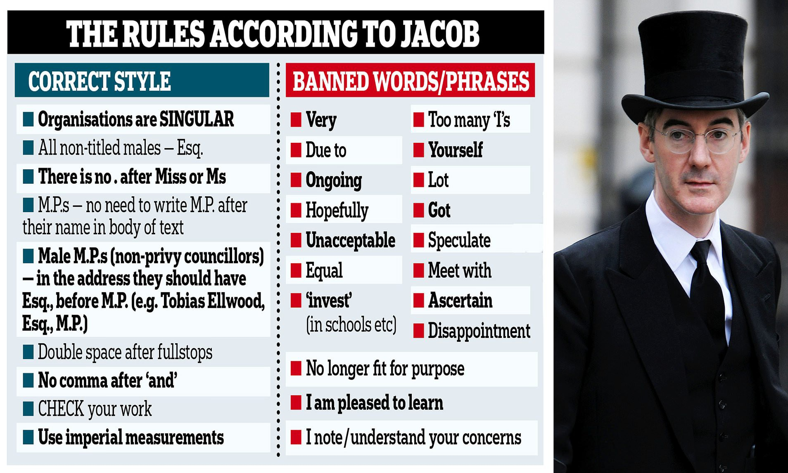
Prescriptive grammars - how we SHOULD speak
01 - Introduction to Linguistics
Nick Riches
Introduction
Why SLTS need to know about linguistics
What is linguistics?
What is syntax? What is semantics? What is pragmatics What is phonology? Crossing over Subfields of linguistics
Approaches to language structure
Prescriptive grammars - how we SHOULD speak
Descriptive grammars - how we ACTUALLY speak
Mental grammars - the underlying system
A communicative view of language
A communicative view
Relationship with SLT practice
5-minute exercise
5-minute ex

Slide 26
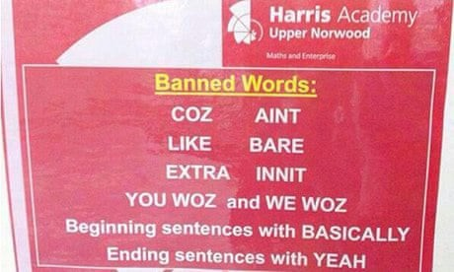
Prescriptive grammars - how we SHOULD speak
01 - Introduction to Linguistics
Nick Riches
Introduction
Why SLTS need to know about linguistics
What is linguistics?
What is syntax? What is semantics? What is pragmatics What is phonology? Crossing over Subfields of linguistics
Approaches to language structure
Prescriptive grammars - how we SHOULD speak
Descriptive grammars - how we ACTUALLY speak
Mental grammars - the underlying system
A communicative view of language
A communicative view
Relationship with SLT practice
5-minute exercise
5-minute ex

Slide 27
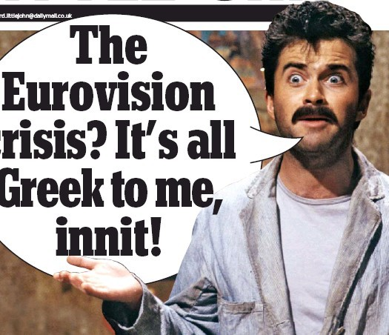
Prescriptive grammars - how we SHOULD speak
01 - Introduction to Linguistics
Nick Riches
Introduction
Why SLTS need to know about linguistics
What is linguistics?
What is syntax? What is semantics? What is pragmatics What is phonology? Crossing over Subfields of linguistics
Approaches to language structure
Prescriptive grammars - how we SHOULD speak
Descriptive grammars - how we ACTUALLY speak
Mental grammars - the underlying system
A communicative view of language
A communicative view
Relationship with SLT practice
5-minute exercise
5-minute ex

Slide 28

Prescriptive grammars - how we SHOULD speak
01 - Introduction to Linguistics
Nick Riches
Introduction
Why SLTS need to know about linguistics
What is linguistics?
What is syntax? What is semantics? What is pragmatics What is phonology? Crossing over Subfields of linguistics
Approaches to language structure
Prescriptive grammars - how we SHOULD speak
Descriptive grammars - how we ACTUALLY speak
Mental grammars - the underlying system
A communicative view of language
A communicative view
Relationship with SLT practice
5-minute exercise
5-minute ex

Slide 29
Prescriptive grammars - how we SHOULD speak
01 - Introduction to Linguistics
Nick Riches
Introduction
Why SLTS need to know about linguistics
What is linguistics?
What is syntax? What is semantics? What is pragmatics What is phonology? Crossing over Subfields of linguistics
1. It
was
a great meal,
wasn’t
it / innit?
2. You
’re
Jack’s nephew, aren’t you /
innit
?
3. They
’ve
been to Greece,
have
n’t they /
innit
?
Approaches to language structure
Prescriptive grammars - how we SHOULD speak
Descriptive grammars - how we ACTUALLY speak
Mental grammars - the underlying system
A communicative view of language
A communicative view
Relationship with SLT practice
5-minute exercise
5-minute ex

Slide 30
Prescriptive grammars - how we SHOULD speak
01 - Introduction to Linguistics
Nick Riches
Introduction
Why SLTS need to know about linguistics
What is linguistics?
What is syntax? What is semantics? What is pragmatics What is phonology? Crossing over Subfields of linguistics
(9) He be working Tuesdays
(10)
He been got a job
Approaches to language structure
Prescriptive grammars - how we SHOULD speak
Descriptive grammars - how we ACTUALLY speak
Mental grammars - the underlying system
A communicative view of language
A communicative view
Relationship with SLT practice
5-minute exercise
5-minute ex

Slide 31
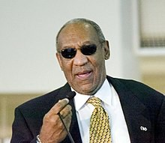
Prescriptive grammars - how we SHOULD speak
01 - Introduction to Linguistics
Nick Riches
Introduction
Why SLTS need to know about linguistics
What is linguistics?
What is syntax? What is semantics? What is pragmatics What is phonology? Crossing over Subfields of linguistics
Approaches to language structure
Prescriptive grammars - how we SHOULD speak
Descriptive grammars - how we ACTUALLY speak
Mental grammars - the underlying system
A communicative view of language
A communicative view
Relationship with SLT practice
5-minute exercise
5-minute ex

Slide 32

Prescriptive grammars - how we SHOULD speak
01 - Introduction to Linguistics
Nick Riches
Introduction
Why SLTS need to know about linguistics
What is linguistics?
What is syntax? What is semantics? What is pragmatics What is phonology? Crossing over Subfields of linguistics
Approaches to language structure
Prescriptive grammars - how we SHOULD speak
Descriptive grammars - how we ACTUALLY speak
Mental grammars - the underlying system
A communicative view of language
A communicative view
Relationship with SLT practice
5-minute exercise
5-minute ex

Slide 33
Prescriptive grammars - how we SHOULD speak
01 - Introduction to Linguistics
Nick Riches
Introduction
Why SLTS need to know about linguistics
What is linguistics?
What is syntax? What is semantics? What is pragmatics What is phonology? Crossing over Subfields of linguistics
’A language is a dialect with an army and a navy’ (Weinreich)
Approaches to language structure
Prescriptive grammars - how we SHOULD speak
Descriptive grammars - how we ACTUALLY speak
Mental grammars - the underlying system
A communicative view of language
A communicative view
Relationship with SLT practice
5-minute exercise
5-minute ex

Slide 34
Descriptive grammars - how we ACTUALLY speak
01 - Introduction to Linguistics
Nick Riches
Introduction
Why SLTS need to know about linguistics
What is linguistics?
What is syntax? What is semantics? What is pragmatics What is phonology? Crossing over Subfields of linguistics
Examples?
Approaches to language structure
Prescriptive grammars - how we SHOULD speak
Descriptive grammars - how we ACTUALLY speak
Mental grammars - the underlying system
A communicative view of language
A communicative view
Relationship with SLT practice
5-minute exercise
5-minute ex

Slide 35
Mental grammars - the underlying system
01 - Introduction to Linguistics
Nick Riches
Introduction
Why SLTS need to know about linguistics
What is linguistics?
What is syntax? What is semantics? What is pragmatics What is phonology? Crossing over Subfields of linguistics
Which of these sentences is correct?
1.
2.
3.
4.
Me and Jack
I and Jack | w
Jack and me
Jack and I
went to the shops
ent to the shops
Approaches to language structure
Prescriptive grammars - how we SHOULD speak
Descriptive grammars - how we ACTUALLY speak
Mental grammars - the underlying system
went to the shops
went to the shops
A communicative view of language
A communicative view
Relationship with SLT practice
5-minute exercise
5-minute ex

Slide 36
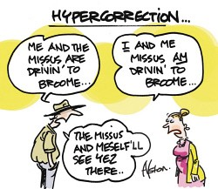
Mental grammars - the underlying system
01 - Introduction to Linguistics
Nick Riches
Introduction
Why SLTS need to know about linguistics
What is linguistics?
What is syntax? What is semantics? What is pragmatics What is phonology? Crossing over Subfields of linguistics
Approaches to language structure
Prescriptive grammars - how we SHOULD speak
Descriptive grammars - how we ACTUALLY speak
Mental grammars - the underlying system
A communicative view of language
A communicative view
Relationship with SLT practice
5-minute exercise
5-minute ex
29 / 32

Slide 37
01 - Introduction to Linguistics
Nick Riches
Introduction
Why SLTS need to know about linguistics
Introduction
What is linguistics?
What is syntax? What is semantics? What is pragmatics What is phonology? Crossing over Subfields of linguistics
What is linguistics?
Approaches to language structure
Approaches to language structure
Prescriptive grammars - how we SHOULD speak
Descriptive grammars - how we ACTUALLY speak
Mental grammars - the underlying system
A communicative view of language
5-minute exercise
A communicative view of language
A communicative view
Relationship with SLT practice
5-minute exercise
5-minute ex
29 / 32

Slide 38
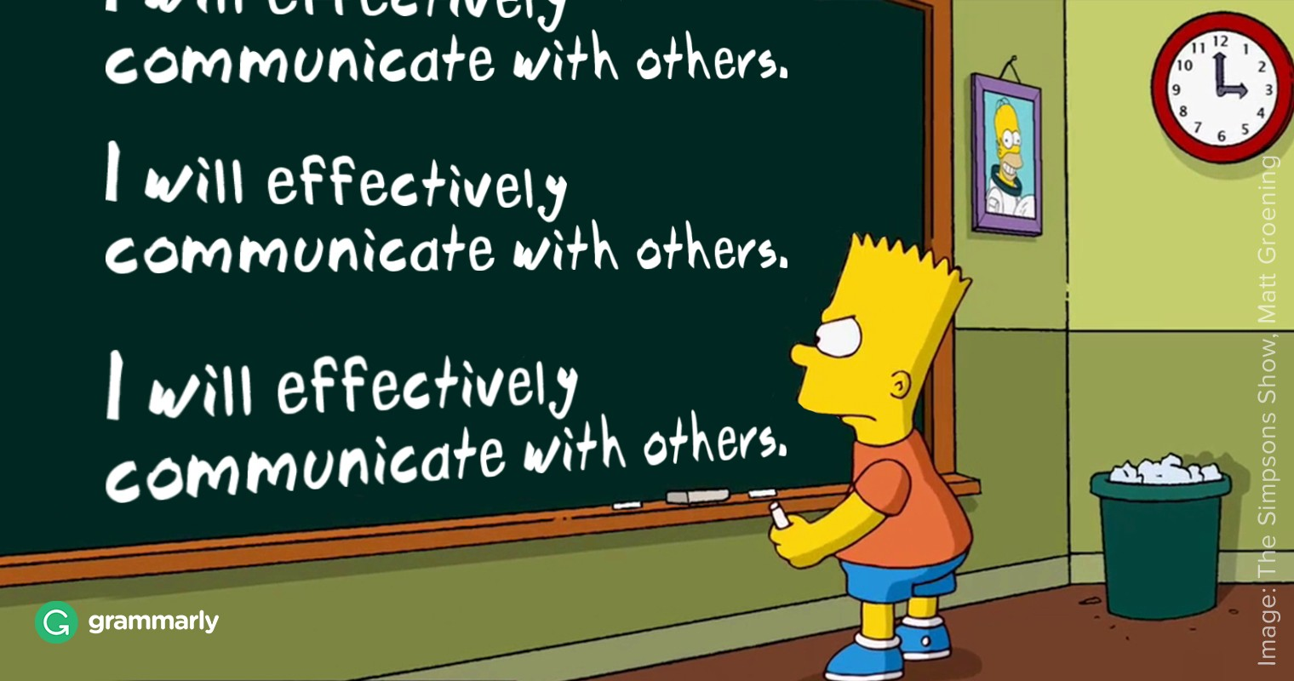
A communicative view
01 - Introduction to Linguistics
Nick Riches
Introduction
Why SLTS need to know about linguistics
What is linguistics?
What is syntax? What is semantics? What is pragmatics What is phonology? Crossing over Subfields of linguistics
Approaches to language structure
Prescriptive grammars - how we SHOULD speak
Descriptive grammars - how we ACTUALLY speak
Mental grammars - the underlying system
A communicative view of language
A communicative view
Relationship with SLT practice
5-minute exercise
5-minute ex

Slide 39

Relationship with SLT practice
01 - Introduction to Linguistics
It is important to be aware of prescriptive assumptions when testing children
Nick Riches
Introduction
Why SLTS need to know about linguistics
What is linguistics?
What is syntax? What is semantics? What is pragmatics What is phonology? Crossing over Subfields of linguistics
Approaches to language structure
Prescriptive grammars - how we SHOULD speak
Descriptive grammars - how we ACTUALLY speak
Mental grammars - the underlying system
A communicative view of language
A communicative view
Relationship with SLT practice
5-minute exercise
5-minute ex

Slide 40
Relationship with SLT practice
01 - Introduction to Linguistics
Nick Riches
Introduction
Why SLTS need to know about linguistics
What is linguistics?
What is syntax? What is semantics? What is pragmatics What is phonology? Crossing over Subfields of linguistics
”The cat that the dog chased was brown”
Approaches to language structure
Prescriptive grammars - how we SHOULD speak
Descriptive grammars - how we ACTUALLY speak
Mental grammars - the underlying system
A communicative view of language
A communicative view
Relationship with SLT practice
5-minute exercise
5-minute ex
32 / 32

Slide 41
Relationship with SLT practice
01 - Introduction to Linguistics
Nick Riches
Introduction
Why SLTS need to know about linguistics
What is linguistics?
What is syntax? What is semantics? What is pragmatics What is phonology? Crossing over Subfields of linguistics
”The cat that the dog chased was brown” ”The cat what the dog chased was brown”
Approaches to language structure
Prescriptive grammars - how we SHOULD speak
Descriptive grammars - how we ACTUALLY speak
Mental grammars - the underlying system
A communicative view of language
A communicative view
Relationship with SLT practice
5-minute exercise
5-minute ex
32 / 32

Slide 42
01 - Introduction to Linguistics
Nick Riches
Introduction
Why SLTS need to know about linguistics
Introduction
What is linguistics?
What is syntax? What is semantics? What is pragmatics What is phonology? Crossing over Subfields of linguistics
What is linguistics?
Approaches to language structure
Approaches to language structure
Prescriptive grammars - how we SHOULD speak
Descriptive grammars - how we ACTUALLY speak
Mental grammars - the underlying system
A communicative view of language
5-minute exercise
A communicative view of language
A communicative view
Relationship with SLT practice
5-minute exercise
5-minute ex
32 / 32

Slide 43
5-minute ex
01 - Introduction to Linguistics
Nick Riches
Introduction
Why SLTS need to know about linguistics
What is linguistics?
What is syntax? What is semantics? What is pragmatics What is phonology? Crossing over Subfields of linguistics
What is the grammatical word class (e.g. noun, verb, adjective etc.) of the italicised words in the following sentences:
Approaches to language structure
Prescriptive grammars - how we SHOULD speak
Descriptive grammars - how we ACTUALLY speak
Mental grammars - the underlying system
The raging river tore through the valley
That film really sucks
A communicative view of language
A communicative view
Relationship with SLT practice
5-minute exercise
5-minute ex
33 / 32

